Slide 1
Capstone Project Predictive Analytics of Taxi Demand
Team1
Great learning – PGPBDA

Slide 2
Data Set Details
Data Set: 2015 Yellow Taxi Trip Data(City of New York)
Data Size: 10.8 GB
Data Source: https://data.cityofnewyork.us/Transportation/2015-Yellow-Taxi-Trip-Data/ba8s-jw6u

Slide 3
Data Attributes
passenger_count
trip_distance
pickup_longitude
pickup_latitude
RateCodeID
store_and_fwd_flag
dropoff_longitude
dropoff_latitude
fare_amount
extra
mta_tax
tip_amount
tolls_amount
total_amount
vendor_id
pickup_datetime
dropoff_datetime
rate_code
payment_type
imp_surcharge

Slide 4
Data Dictionary
http://www.nyc.gov/html/tlc/downloads/pdf/data_dictionary_trip_records_yellow.pdf
Data further enriched with Weather attributes like Temp., Visibility, Precipitation and Conditions (e.g.; Rainy, Partly Cloudy etc.)
Also whether the day is Public holiday

Slide 5
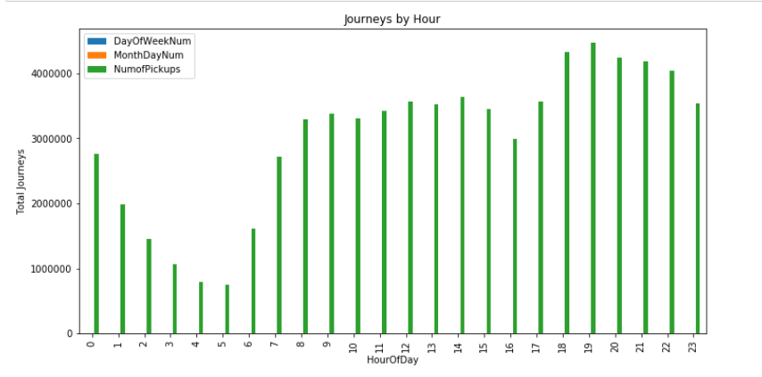
Hourly Demand Analysis

Slide 6
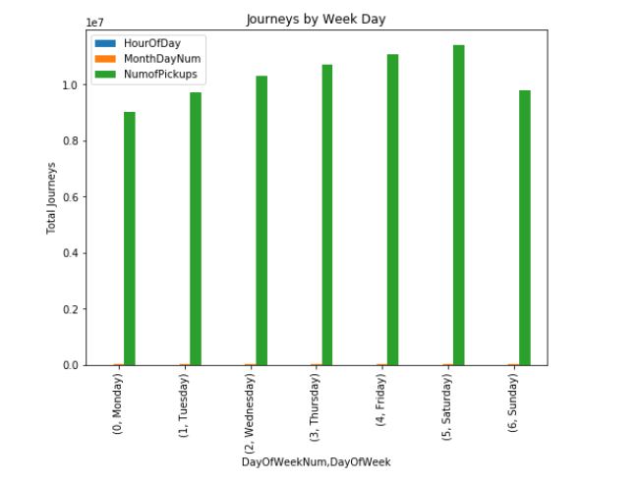
Demand Analysis on Week Day basis

Slide 7
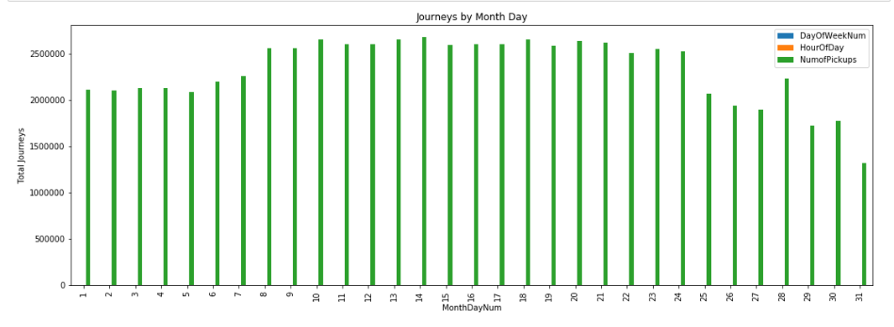
Demand Analysis on Month Day basis

Slide 8
R Libraries Used
library(fst)
library(zoo)
library(lubridate)
library(dplyr)
library(data.table)
library(forecast)
library(TSA)
Notes:
The fst package for R provides a fast, easy and flexible way to serialize data frames. With access speeds of multiple GB/s, fst is specifically designed to unlock the potential of high speed solid state disks that can be found in most modern computers. Data frames stored in the fst format have full random access, both in column and rows.
Library(zoo)
An S3 class with methods for totally ordered indexed observations. It is particularly aimed at irregular time series of numeric vectors/matrices and factors. zoo's key design goals are independence of a particular index/date/time class and consistency with ts and base R by providing methods to extend standard generics.
library(lubridate)
R package that makes it easier to work with dates and times.
library(dplyr)
A fast, consistent tool for working with data frame like objects, both in memory and out of memory.
library(data.table)
n Fast aggregation of large data (e.g. 100GB in RAM), fast ordered joins, fast add/modify/delete of columns by group using no copies at all, list columns, a fast friendly file reader and parallel file writer. Offers a natural and flexible syntax, for faster development.
library(forecast)
Methods and tools for displaying and analysing univariate time series forecasts including exponential smoothing via state space models and automatic ARIMA modelling.
library(TSA)

Slide 9
Rounding up Latitude-Longitude up to 2 Decimal
Dividing New York map in 4 sections based on Lat-Long
Data Aggregation on Half Hourly basis to reduce data size and create a model

Slide 10
Lag 24 is 12 hours
Lag 48 is 24 hours
Lag 336 is 1 week

Slide 11
Time Series
Uni variate Time Series
As demand forecasting will be done by pickup trend

Slide 12
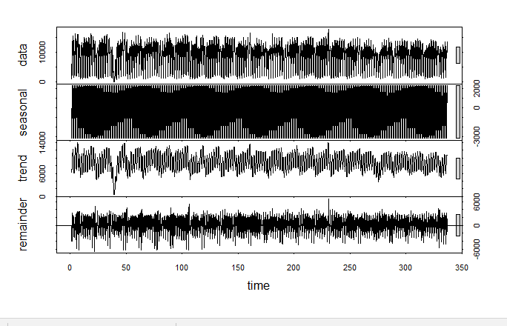
Decomposition of Time Series for lag 24

Slide 13
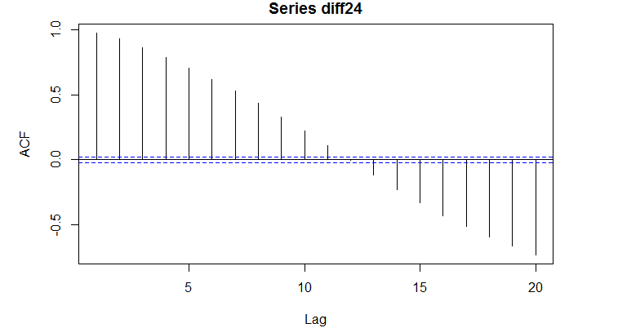
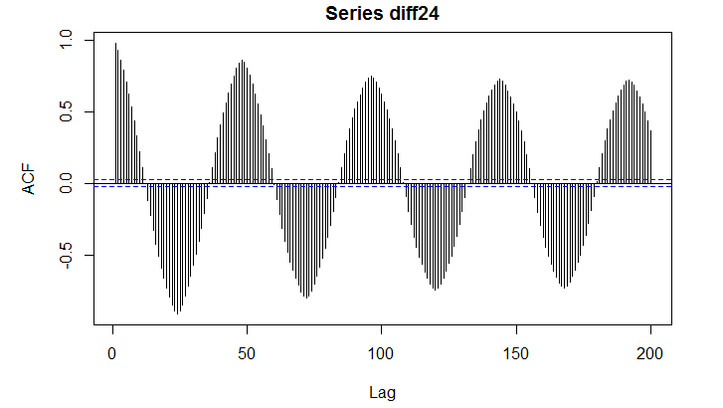
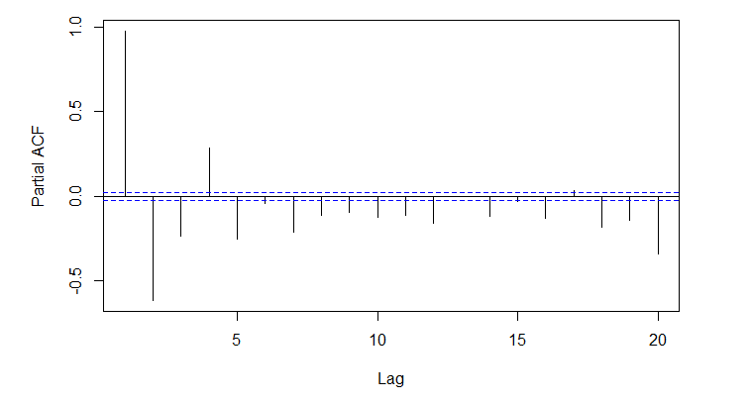
Trend – Diff24((p,d,q) = (3,0,11) or (5,0,11))
Seasonality – Diff24((P,D,Q) = (10,1,8))

Slide 14
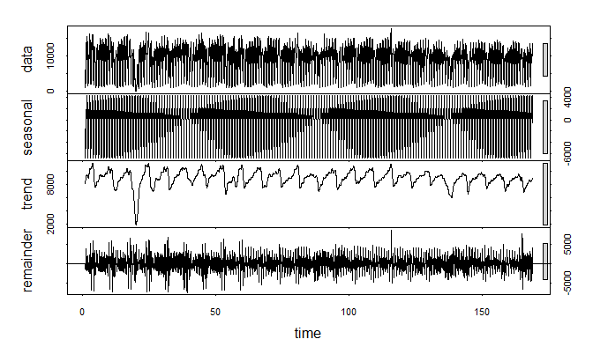
Decomposition of Time Series for lag 48

Slide 15
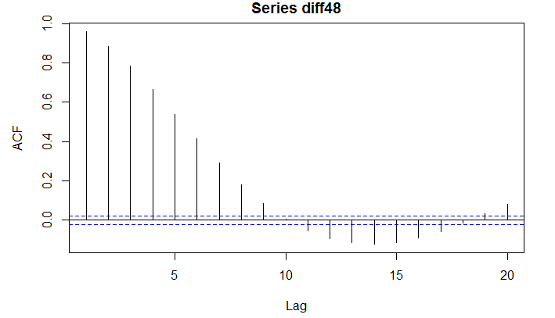
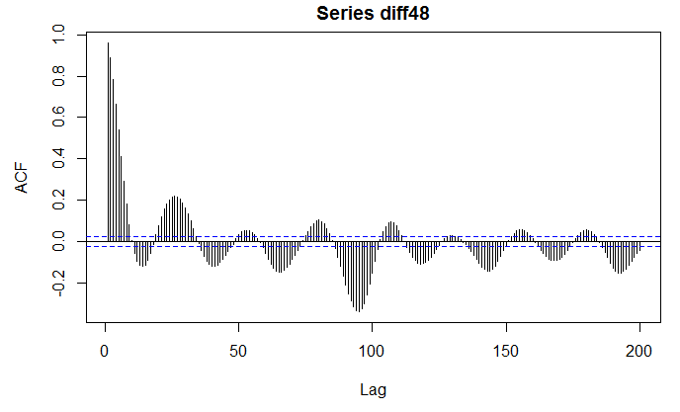
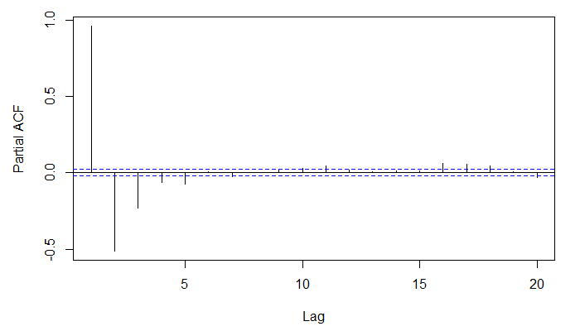
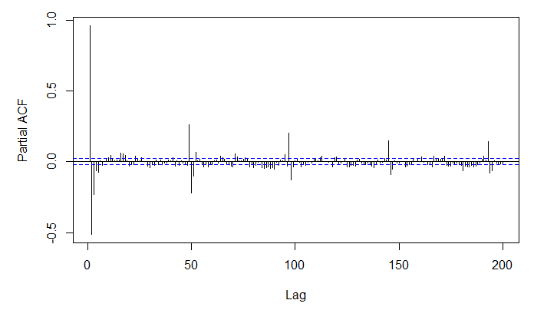
Trend – Diff 48((p,d,q) = (3,0,10))
Seasonality – Diff 48((P,D,Q) = (7,1,3))

Slide 16
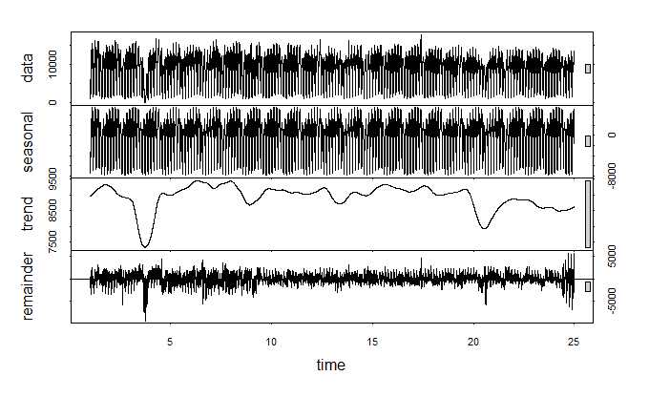
Decomposition of Time Series for lag 336

Slide 17
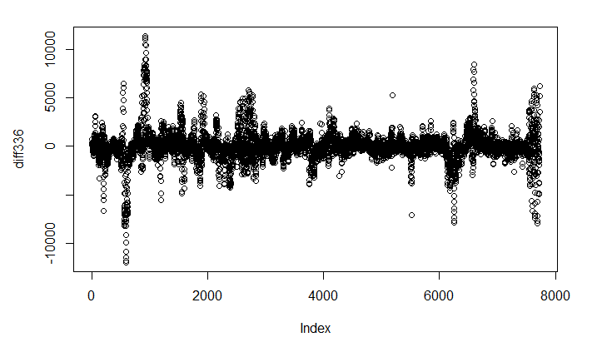
Seasonality Graph for Diff 336

Slide 18
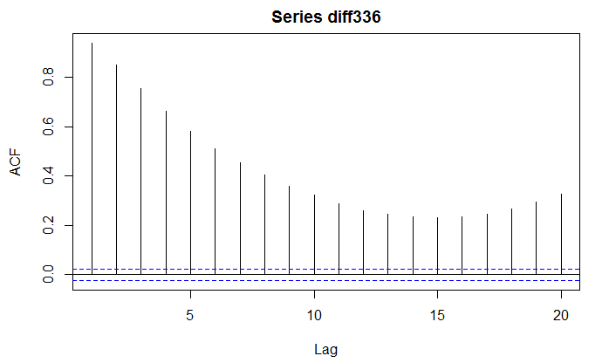
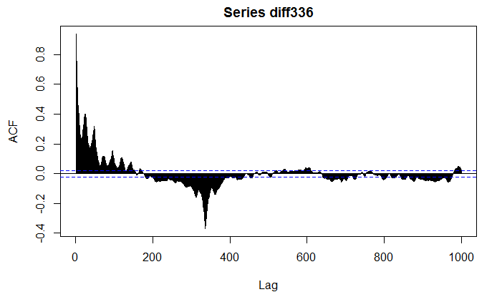
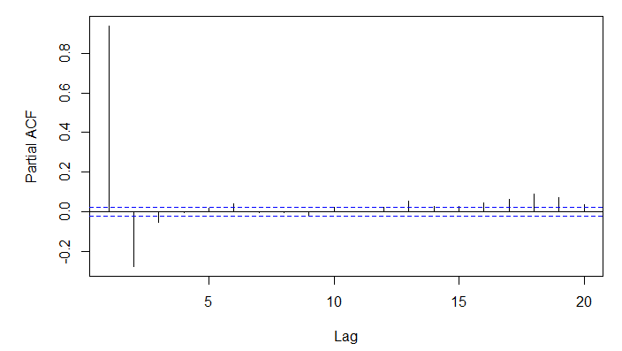
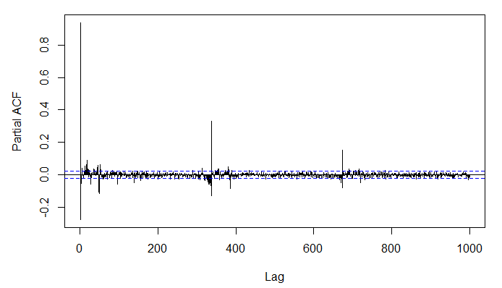
Trend – Diff 336((p,d,q) = (1,1,1))
Seasonality – Diff 336((P,D,Q) = (2,1,3))

Slide 19
ARIMA - MAPE
Mape = 30.50581
MAPE_mult = 19.48408
mean(result_comp$diff/result_comp$actual)
=0.2848019
MAPE_add = 37.81035

Slide 20
TBATS

Slide 21
Decision Tree

Slide 22
Random Forest

Slide 23
Artificial Neural Network

Slide 24
Cab Companies

